Slide 1
Unit 3
Sixth grade
Environmentally speaking
Week 1
L.1 Recognizes the dialogue of a movie; cartoon or documentary.

Slide 2
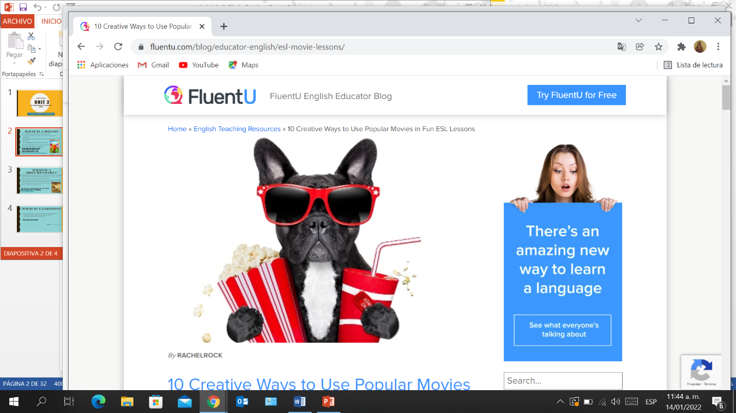
What is the dog about to do?

Slide 3
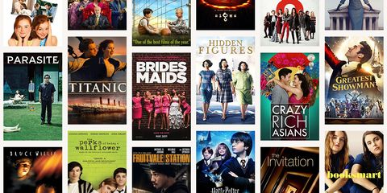
What is a movie?
It is a type of visual communication scenario which uses moving pictures and sound to tell stories or teach people something.
Most people watch (view) movies as a type of entertainment or a way to have fun.
For some people, fun movies can mean movies
that make them laugh, while for others it can mean
movies that make them cry, or feel afraid.
Can you mention some examples of movies?
Can you mention some types of movies?
Definition taken from https://simple.wikipedia.org/wiki/Movie

Slide 4
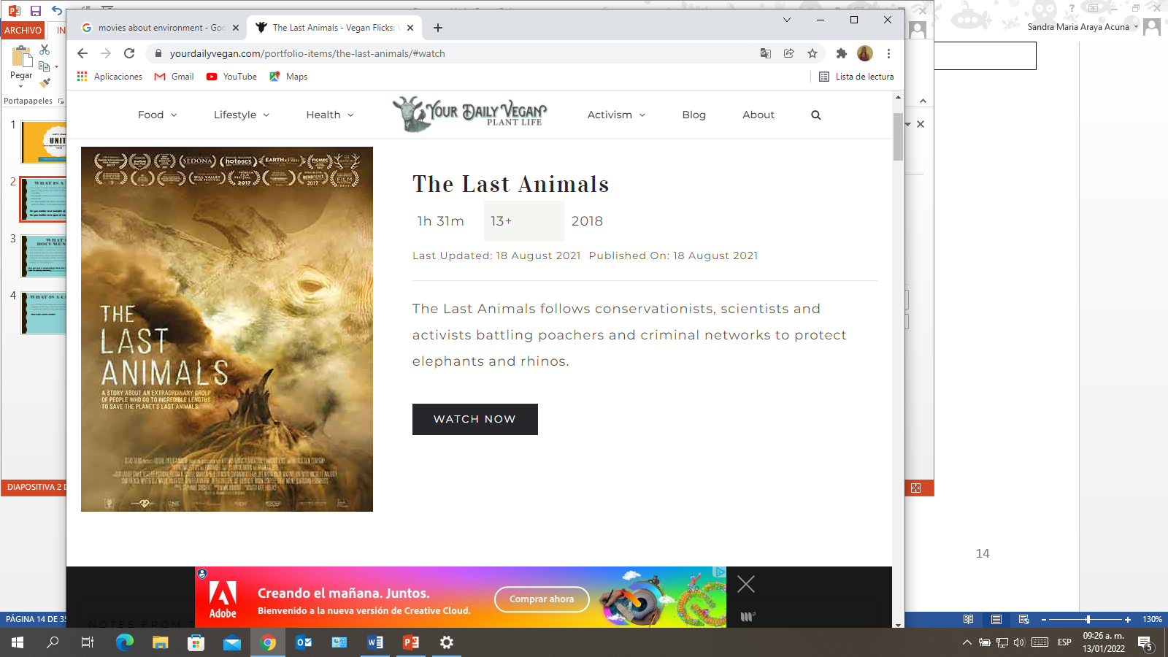
What is a documentary?
Documentaries are movies that are (or claim to be) about real people and real events. It documents (creates a record of) a true story.
They explain why and how something happened.
They are nearly always serious and may involve strongly emotional subjects, for example cruelty, environmental issues, etc.
A documentary may be a video or audio recording,
such as a movie or radio program.
Have you seen a documentary? What was it about?
Watch the following trailer of a documentary
https://youtu.be/8VToxlkKH1A
Definition taken from https://simple.wikipedia.org/wiki/Movie and https://simple.wikipedia.org/wiki/Documentary

Slide 5
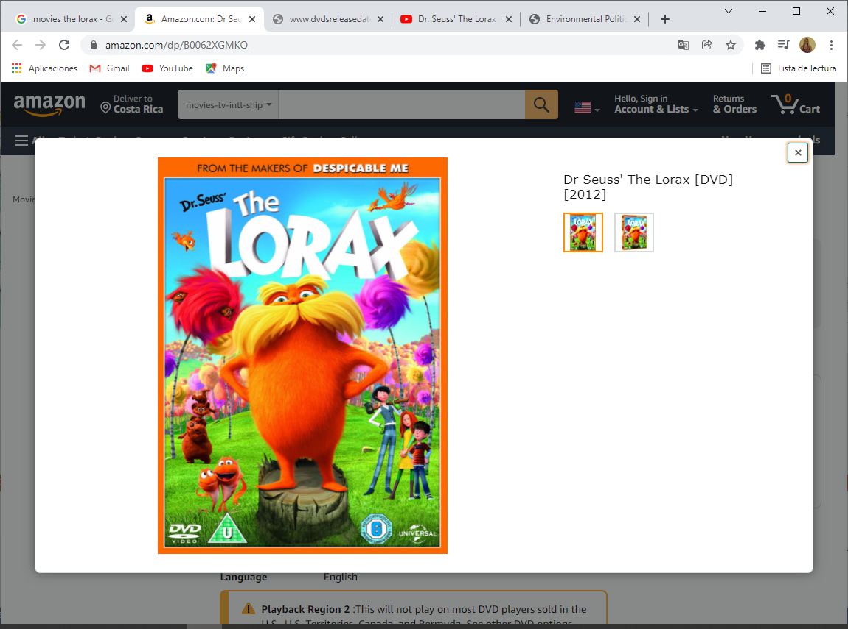
What is a cartoon?
It is a motion picture using animation techniques to photograph a sequence of drawings rather than real people or objects.
It often depict animals rather than humans.
What is your favorite cartoon?
Watch the following trailer of an animated movie https://www.youtube.com/watch?v=1bHdzTUNw-4
Definition taken from https://www.merriam-webster.com/dictionary/animated%20cartoon

